Slide 1

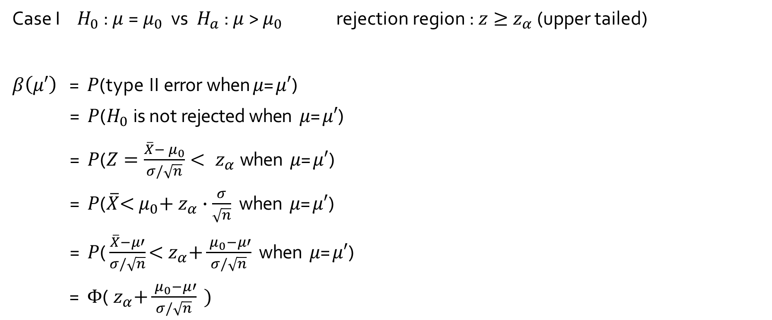
$β$ and sample size computation
Case I $H_{0}$ : $μ$=${ μ}_{0}$ vs $H_{a}$ : $μ$> $μ_{0}$ rejection region : $z≥{ z}_{α}$ (upper tailed)
$β\left(μ′\right) \text{=} P\text{(}\text{t}\text{y}\text{p}\text{e} \text{I}\text{I} \text{err}\text{o}\text{r} \text{when} μ\text{=}μ′\text{)}$
$\text{ = }P\text{(}H_{0} \text{i}\text{s} \text{no}\text{t} \text{rejecte}\text{d} \text{when} μ\text{=}μ′\text{)}$
$\text{ = }P\text{(}Z=\frac{\overline{X}−{ μ}_{0}}{σ/\sqrt{n}}<{ z}_{α} \text{when} μ\text{=}μ′\text{)}$
$\text{ = }P\text{(}\overline{X}\text{<}{ μ}_{0}\text{+}{ z}_{α}∙\frac{σ}{\sqrt{n}} \text{when} μ\text{=}μ′\text{)}$
$\text{= }P\text{(}\frac{\overline{X}−μ′}{σ/\sqrt{n}}\text{<}{ z}_{α}\text{+}\frac{{ μ}_{0}−μ′}{σ/\sqrt{n}} \text{when} μ\text{=}μ′\text{)}$
$\text{ = }Φ\text{(}{ z}_{α}\text{+}\frac{{ μ}_{0}−μ′}{σ/\sqrt{n}} )$

Slide 2
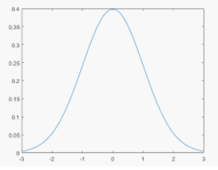
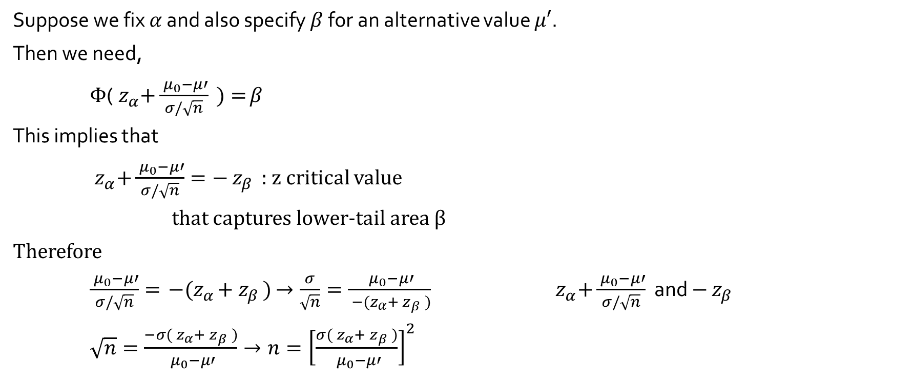

$β$ and sample size computation
Suppose we fix $α$ and also specify $β$ for an alternative value $μ′$.
Then we need,
$Φ\text{(}{ z}_{α}\text{+}\frac{{ μ}_{0}−μ′}{σ/\sqrt{n}} )=$ $β$
This implies that
${ z}_{α}\text{+}\frac{{ μ}_{0}−μ′}{σ/\sqrt{n}}=−{ z}_{β }$ : $z$ critical value
that captures lower-tail area $β$
Therefore
$\frac{{ μ}_{0}−μ′}{σ/\sqrt{n}}={ −(z}_{α}+{ z}_{β })$ $→\frac{σ}{\sqrt{n}}=\frac{{ μ}_{0}−μ′}{{ −(z}_{α}+{ z}_{β })}$ ${ z}_{α}\text{+}\frac{{ μ}_{0}−μ′}{σ/\sqrt{n}}$ and $−{ z}_{β }$
$\sqrt{n}=\frac{−σ({ z}_{α}+{ z}_{β })}{{ μ}_{0}−μ′}→n={\left[\frac{σ({ z}_{α}+{ z}_{β })}{{ μ}_{0}−μ′}\right]}^{2}$
$$β$$

Slide 3
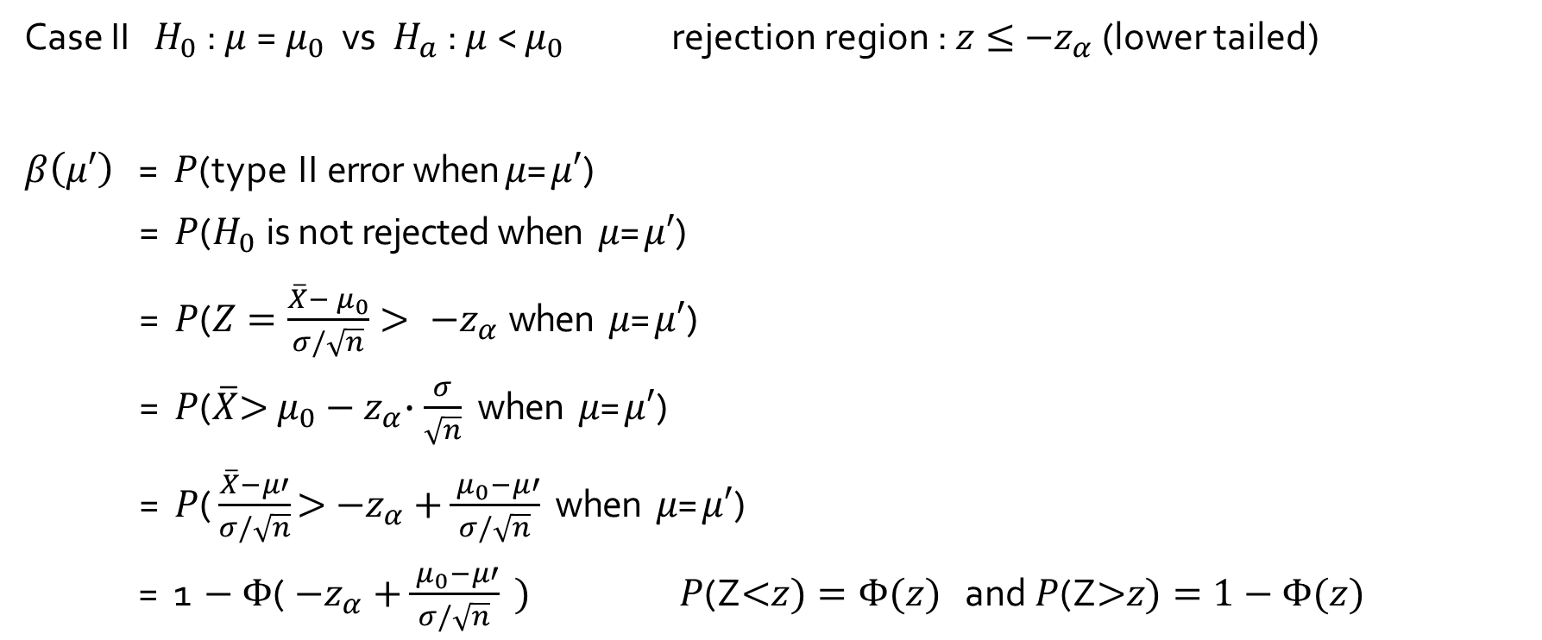
$β$ and sample size computation
Case II $H_{0}$ : $μ$=${ μ}_{0}$ vs $H_{a}$ : $μ$< $μ_{0}$ rejection region : $z≤{ −z}_{α}$ (lower tailed)
$β\left(μ′\right) \text{=} P\text{(}\text{t}\text{y}\text{p}\text{e} \text{I}\text{I} \text{err}\text{o}\text{r} \text{when} μ\text{=}μ′\text{)}$
$\text{ = }P\text{(}H_{0} \text{i}\text{s} \text{no}\text{t} \text{rejecte}\text{d} \text{when} μ\text{=}μ′\text{)}$
$\text{ = }P\text{(}Z=\frac{\overline{X}−{ μ}_{0}}{σ/\sqrt{n}}>{ −z}_{α} \text{when} μ\text{=}μ′\text{)}$
$\text{ = }P\text{(}\overline{X}\text{>}{ μ}_{0}−{ z}_{α}∙\frac{σ}{\sqrt{n}} \text{when} μ\text{=}μ′\text{)}$
$\text{= }P\text{(}\frac{\overline{X}−μ′}{σ/\sqrt{n}}\text{>}{−z}_{α}\text{+}\frac{{ μ}_{0}−μ′}{σ/\sqrt{n}} \text{when} μ\text{=}μ′\text{)}$
$\text{ = }\text{1}−Φ\text{(}{−z}_{α}\text{+}\frac{{ μ}_{0}−μ′}{σ/\sqrt{n}} )$ $P\text{(}\text{Z}\text{<}z)=Φ(z)$ and $P\text{(}\text{Z}\text{>}z)=1−$ $Φ(z)$

Slide 4
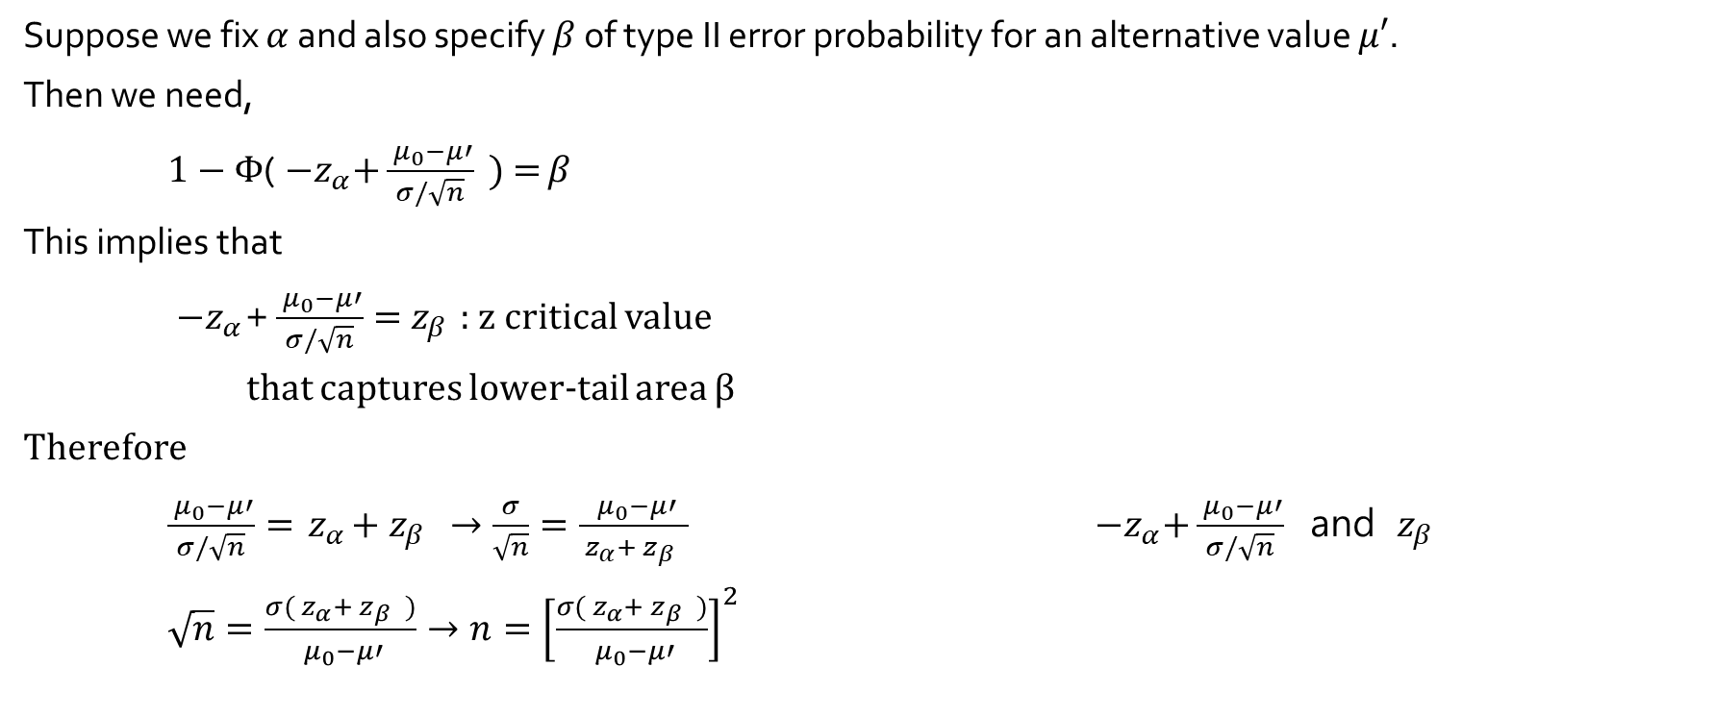

$β$ and sample size computation
Suppose we fix $α$ and also specify $β$ of type II error probability for an alternative value $μ′$.
Then we need,
$1−Φ\text{(}{ −z}_{α}\text{+}\frac{{ μ}_{0}−μ′}{σ/\sqrt{n}} )=$ $β$
This implies that
${ −z}_{α}\text{+}\frac{{ μ}_{0}−μ′}{σ/\sqrt{n}}={ z}_{β }$: $z$ critical value
that captures lower-tail area $β$
Therefore
$\frac{{ μ}_{0}−μ′}{σ/\sqrt{n}}={ z}_{α}+{ z}_{β }$ $→\frac{σ}{\sqrt{n}}=\frac{{ μ}_{0}−μ′}{{ z}_{α}+{ z}_{β }}$ ${ −z}_{α}\text{+}\frac{{ μ}_{0}−μ′}{σ/\sqrt{n}}$ and ${ z}_{β }$
$\sqrt{n}=\frac{σ({ z}_{α}+{ z}_{β })}{{ μ}_{0}−μ′}→n={\left[\frac{σ({ z}_{α}+{ z}_{β })}{{ μ}_{0}−μ′}\right]}^{2}$
$$β$$

Slide 5
β(μ’) Summary

